Slide 1

FPGA lock system

Slide 2
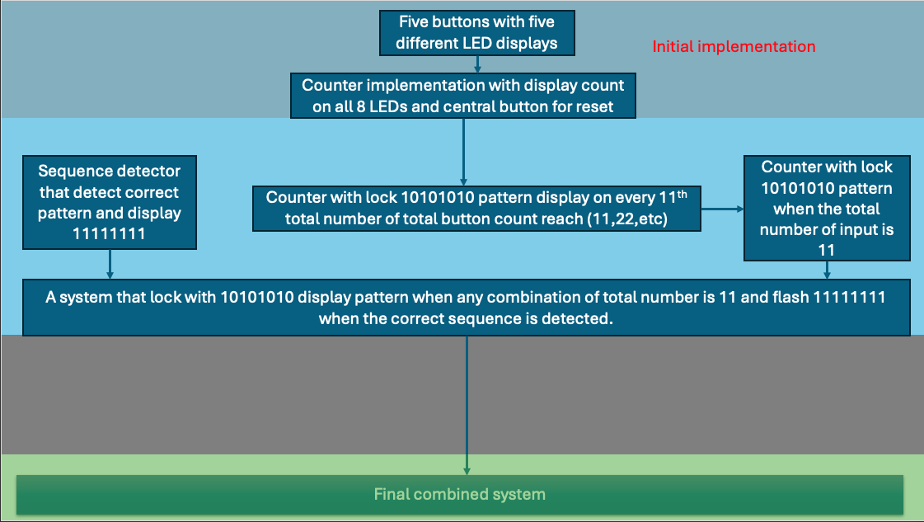

Slide 3
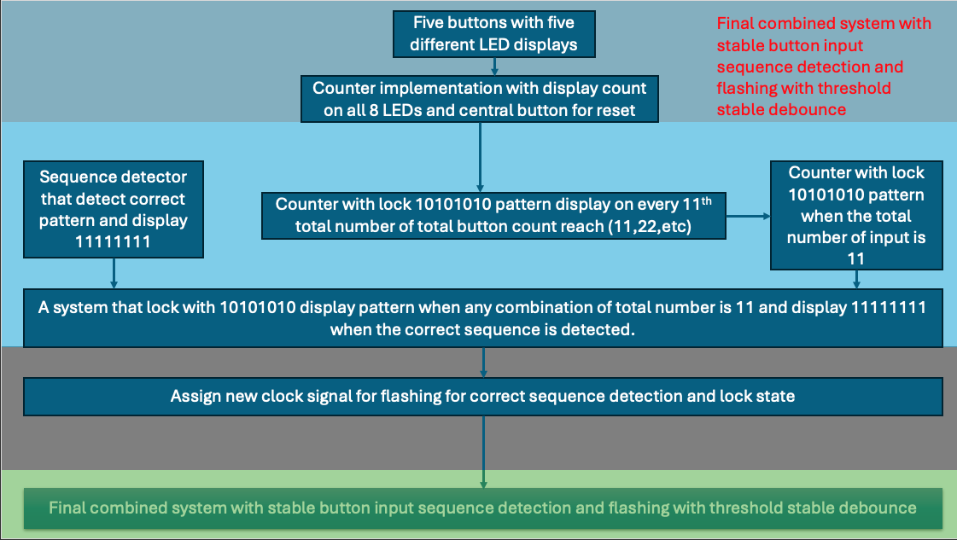

Slide 4
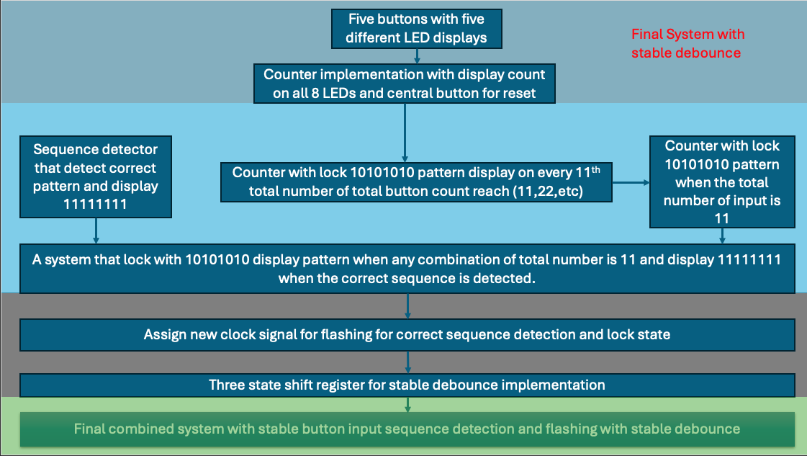

Slide 5



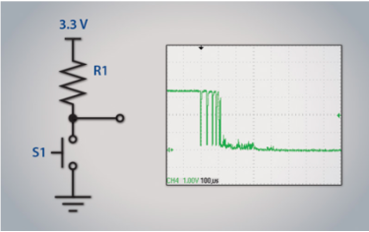
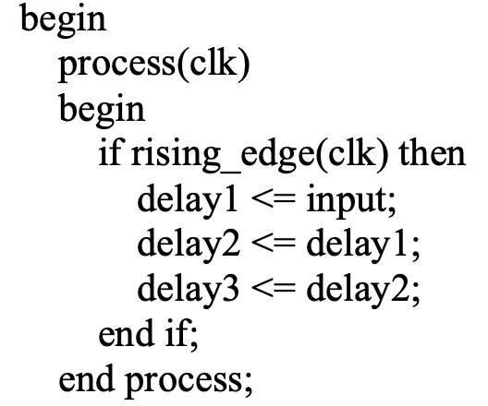
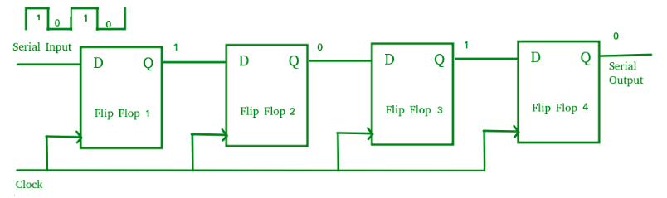
Common shift register types
SISO- Serial in Serial out
SIPO- Serial in Parallel out
PISO- Parallel in serial out
Clock Cycle | Raw Input (input) | delay1 | delay2 | delay3 | Debounced Output
1 | 0 | 0 | 0 | 0 | 0
2 | 1 (bounce starts) | 1 | 0 | 0 | 0
3 | 0 (bounce) | 0 | 1 | 0 | 0
4 | 1 (bounce ends) | 1 | 0 | 1 | 0
5 | 1 (stable) | 1 | 1 | 0 | 1
6 | 1 | 1 | 1 | 1 | 0

Slide 6
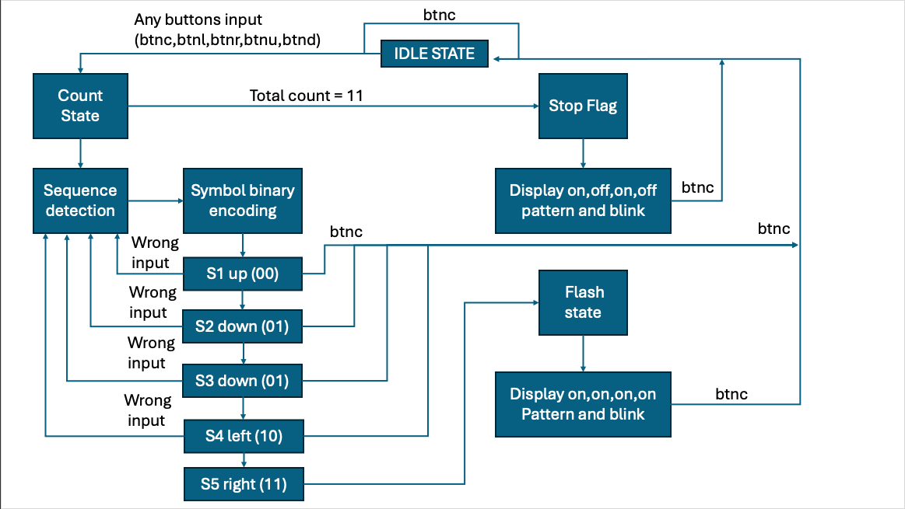
FSM overview

Slide 7
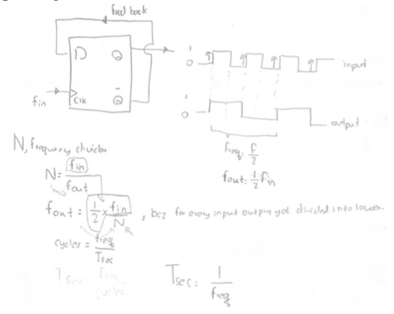
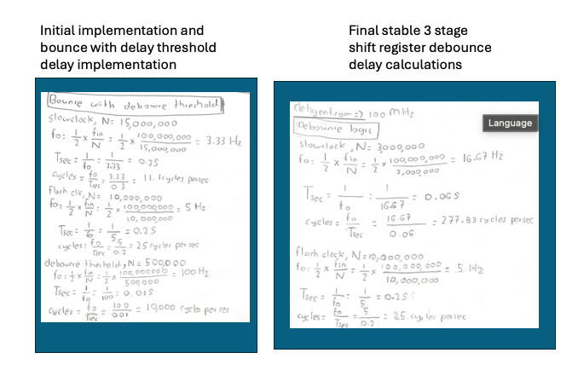

Slide 8
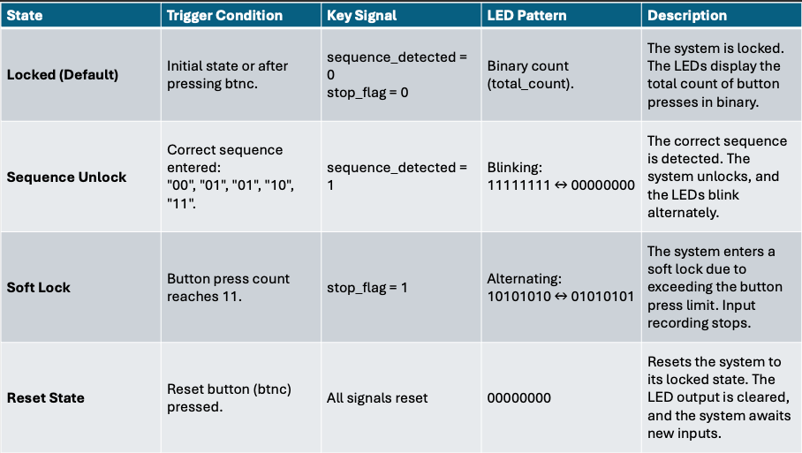

Slide 9
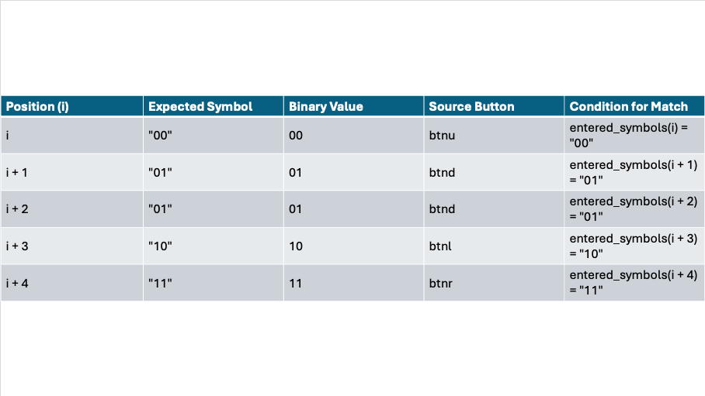

Slide 10
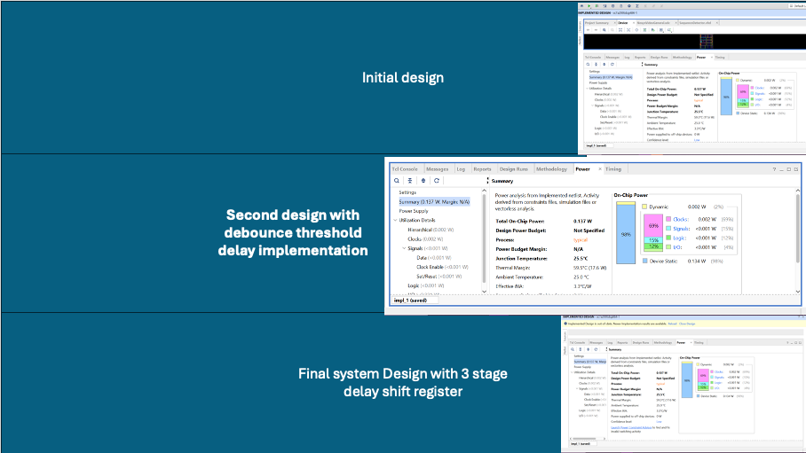

Slide 11
Appendix codes references

Slide 12
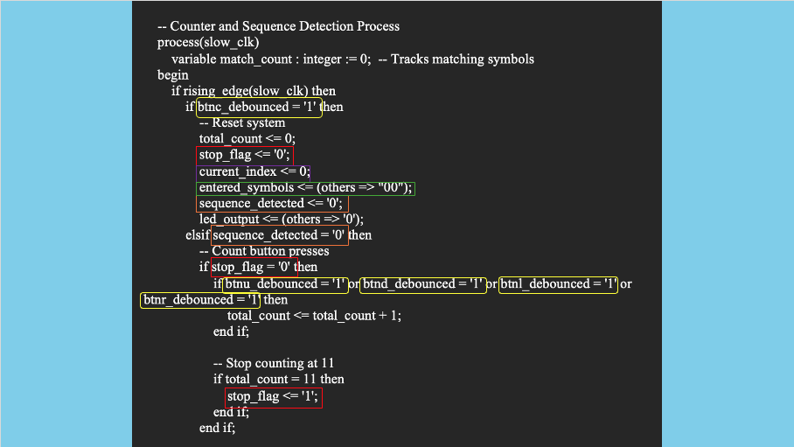

Slide 13
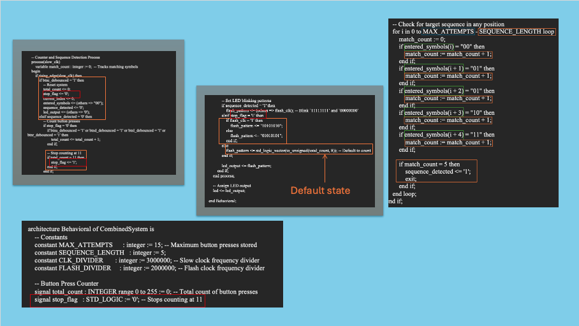

Slide 14
